Slide 1


CS 6831 Designing Secure Cryptography
Tom Ristenpart

Slide 2
Randomized symmetric encryption
Randomized encryption
Definitions: IND$, IND-CPA, IND-SIM
OCB core
CTR mode
CBC mode
Deficiencies in face of active attacks

Slide 3
CPA-core of OCB mode
Tweakable block ciphers can fix all this!
Let N be an n-bit nonce (only use once)
and use XE mode (or other suitable tweakable BC):
M1
M2
M3
C1
C2
C3
Remember our tweakable block cipher mode XE:

Slide 4
Randomized encryption
Symmetric encryption scheme is tuple
(randomized) key generation
(randomized) encryption
(deterministic) decryption
Assume length of ciphertext determined solely by length of message: clen(|M|)

Slide 5
Real-or-random indistinguishability
Can’t distinguish from random bits under chosen-message attack
Adversary can repeatedly query Enc on same message

Slide 6
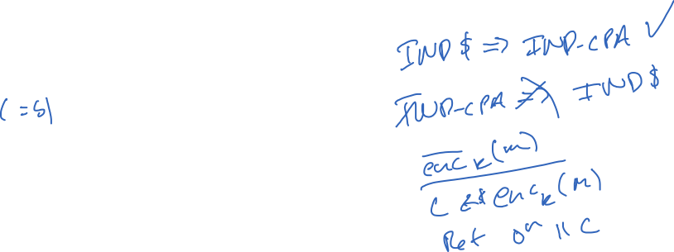


IND-CPA (indistinguishability under chosen-plaintext attack)
Can’t infer which of two messages encrypted
Queries must be such that |M₀| = |M₁|
What is relationship between IND-CPA and IND$?

Slide 7
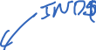

Slide 8
Simulation-based security
Having ciphertext is as good as not having ciphertext.
S is called a simulator. Randomized algorithm
What is relationship between IND-CPA, IND-SIM, and IND$?
Showing security: give S for which advantage low for any efficient A
Showing insecurity: give A for which advantage high for any efficient S

Slide 9

IND$ => IND-SIM

Slide 10
CPA definitions recap
Many ways to define confidentiality under chosen-plaintext attack (CPA) for symmetric encryption
IND-CPA is classic one
Inherited from asymmetric encryption literature
IND$ is used widely too
Generally both easier to work with and strictly stronger
IND-SIM is not as widely used
Introduced pedagogical purposes: introduction to simulator-based defs
We’ll see that CPA is not nearly strong enough for practical use
But useful conceptual and technical building block

Slide 11

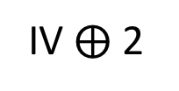
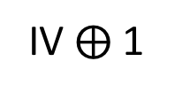
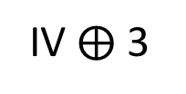
CTR mode from a block cipher
IV $⨁$ 1
IV $⨁$ 2
IV $⨁$ 3
IV is random 128 bit value
E_{K}
E_{K}
E_{K}
P1
P2
P3
M1
M2
M3
C1
C2
C3
Key generation simply picks random k-bit key

Slide 12
IND$ of CTR mode
Proof is tight: attack that recovers partial plaintext data with q $≈$ 2^{n/2}
Proofs of similar results in Boneh-Shoup (Thm 5.3) & Bellare-Rogaway (Thm 5.14)

Slide 13
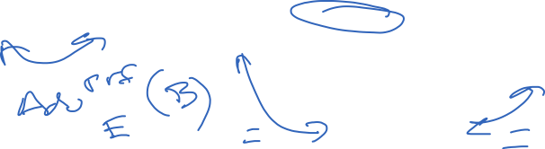


Slide 14
Notes:
If mi < 2n − 1 for all queries then we can ignore wraparound effects, and so no collisions on each row.
Now consider any two pairs of rows 1 < i < j.
We can consider IVi to be fixed, and so a collision across rows occurs if
IVj ∈ {IVi + α : −σ + 1 ≤ α ≤ σ − 1}.
This occurs with probability (2σ − 1)/2n.
Since there are at most q2 such pairs,
we have that the total probability of a collision is at most 2q2σ/2n.

Slide 16





Slide 17



CFB mode
Ciphertext feedback mode (CFB)
Pad message M to M[1],M[2],M[3],... where each block M[i] is n bits
Choose random n-bit string IV
Then:
IV
E_{K}
E_{K}
E_{K}
M[1]
M[2]
M[3]
C0
C1
C2
C3
How do we decrypt?

Slide 18
OFB mode
Offset feedback mode (OFB)
Pad message M to M[1],M[2],M[3],... where each block M[i] is n bits
Choose random n-bit string IV
Then:
IV
E_{K}
E_{K}
E_{K}
M[1]
M[2]
M[3]
C0
C1
C2
C3
How do we decrypt?

Slide 19


CBC mode for block cipher
How do we do padding?
IV is random 128 bit value
M₁
M₂
M₃
IV
E_{K}
E_{K}
E_{K}
C₀
C₁
C₂
C₃
Can prove similar bounds for CBC mode with similar birthday-bounds loss

